Slide 1

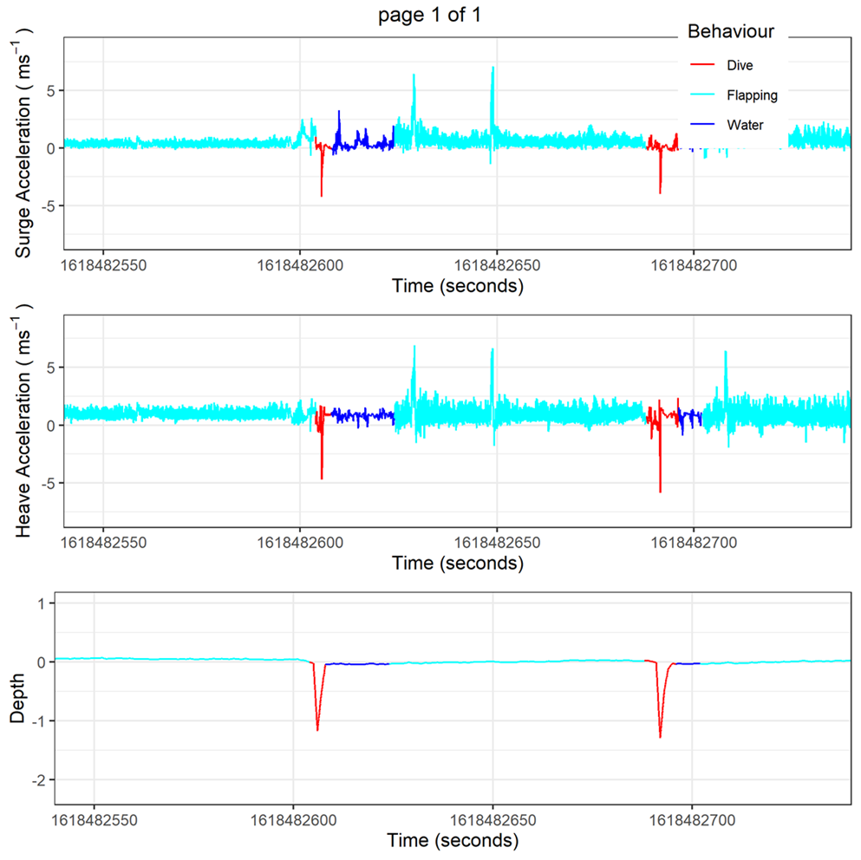
Data Curation, Handling, and Interpretation of Accelerometery Data
SARAH SALDANHA, NUNO QUEIROZ, JESSICA HARVEY

Slide 2
Overview
Day 1: Turtles → ground truthing with Boris
Day2: Sharks → Igor Pro
Day 3: Seabirds → Framework4 & Semi-supervised HMMs

Slide 3
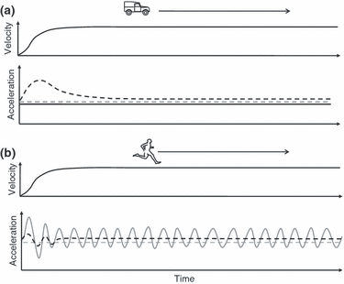
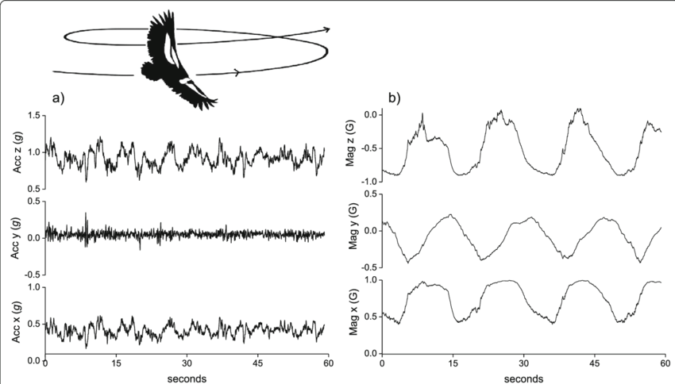
How do accelerometers work?
Measure acceleration
High sampling interval allows you to patterns in acceleration = very large files

Slide 4
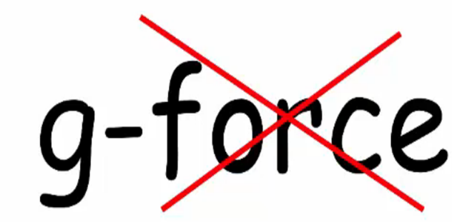
How do accelerometers work?
Accelerometers measure changes in g-force
= Gravity + Inertial force

Slide 5
How do accelerometers work?
Accelerometers measure changes in g-force
= Gravity + Inertial force

Slide 6

How do accelerometers work?
Earths gravitational pull = 1g (9.8m/s)
Always a 1g acceleration even when the axy is at rest!

Slide 7
How do accelerometers work?
Accelerometers measure changes in g-force
= Gravity + Inertial force

Slide 8
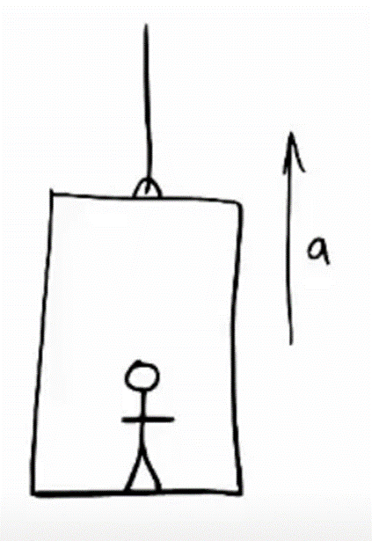
G-force
law of inertia: (Newton's first law): if a body is at rest or moving at a constant speed in a straight line, it will remain at rest or keep moving in a straight line at constant speed unless it is acted upon by a force.
gravity + inertial force are in the same direction =
Heavy !!!!
For more info: https://www.youtube.com/watch?v=VKcmgPTKLMI&t=129s

Slide 9
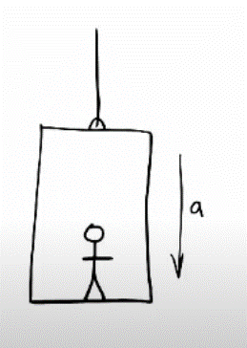
G-force
gravity + inertial force different directions =

Slide 10
G-force
gravity + inertial force different directions =
Light !!!!

Slide 11
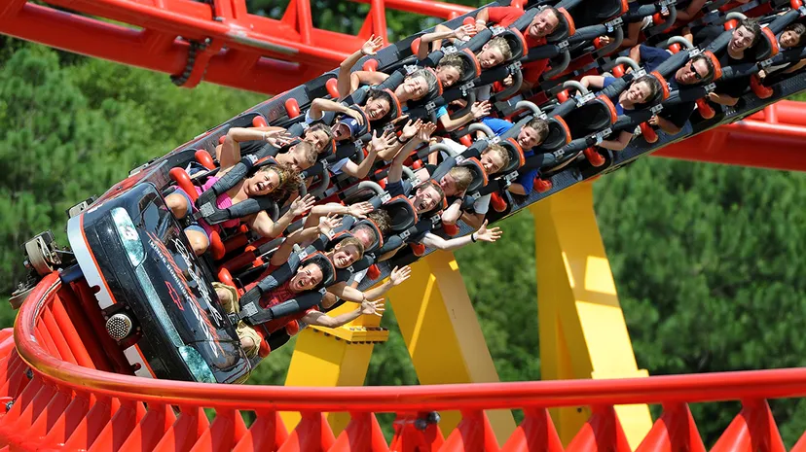
G-force
Not only up and down!

Slide 12
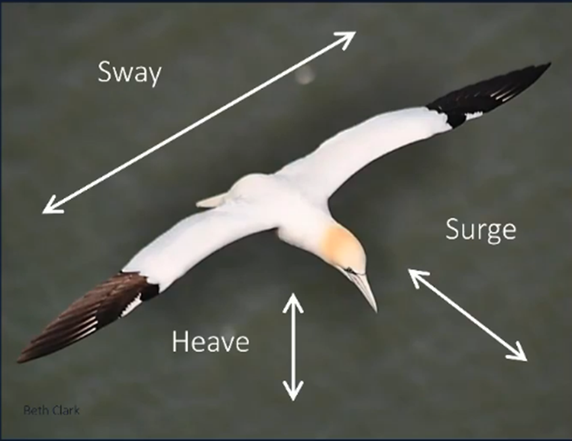
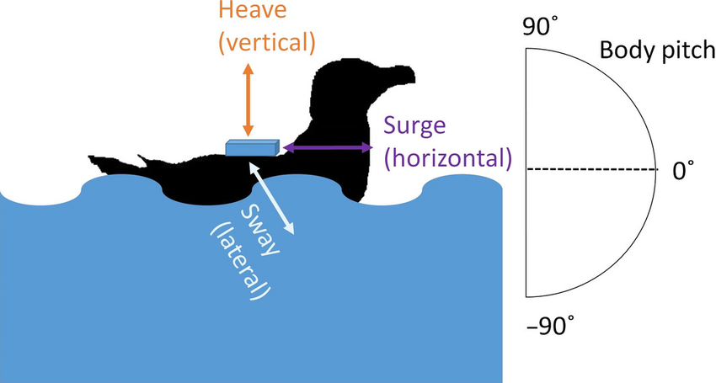
Tri-axial accelerometry
3 Axys of acceleration!

Slide 13
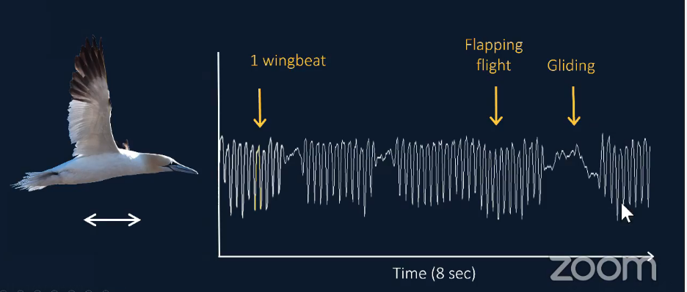
Proxy for energy and behaviours

Slide 14
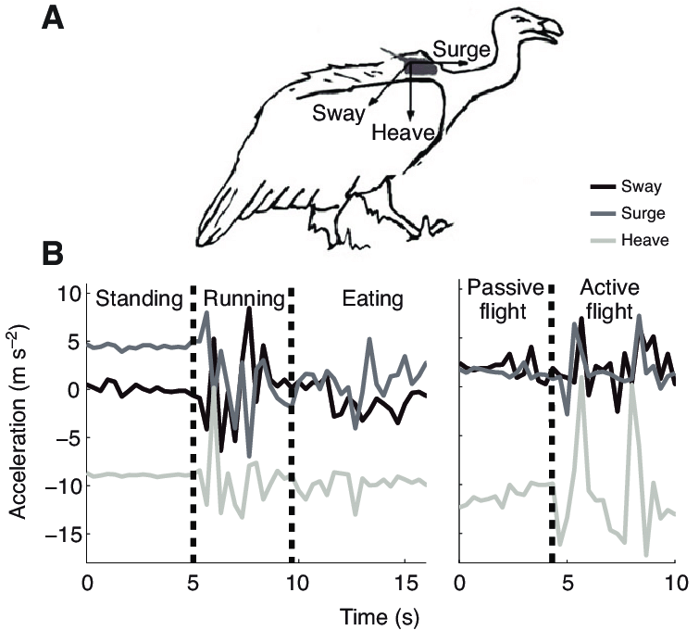
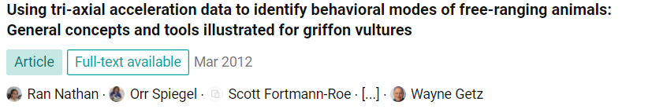
Need:
High frequency (at least half the duration of a behaviour)
Prior knowledge of the animal’s behaviours

Slide 15
Need:
High frequency (at least half the duration of a behaviour)
Prior knowledge of the animal’s behaviours

Slide 16
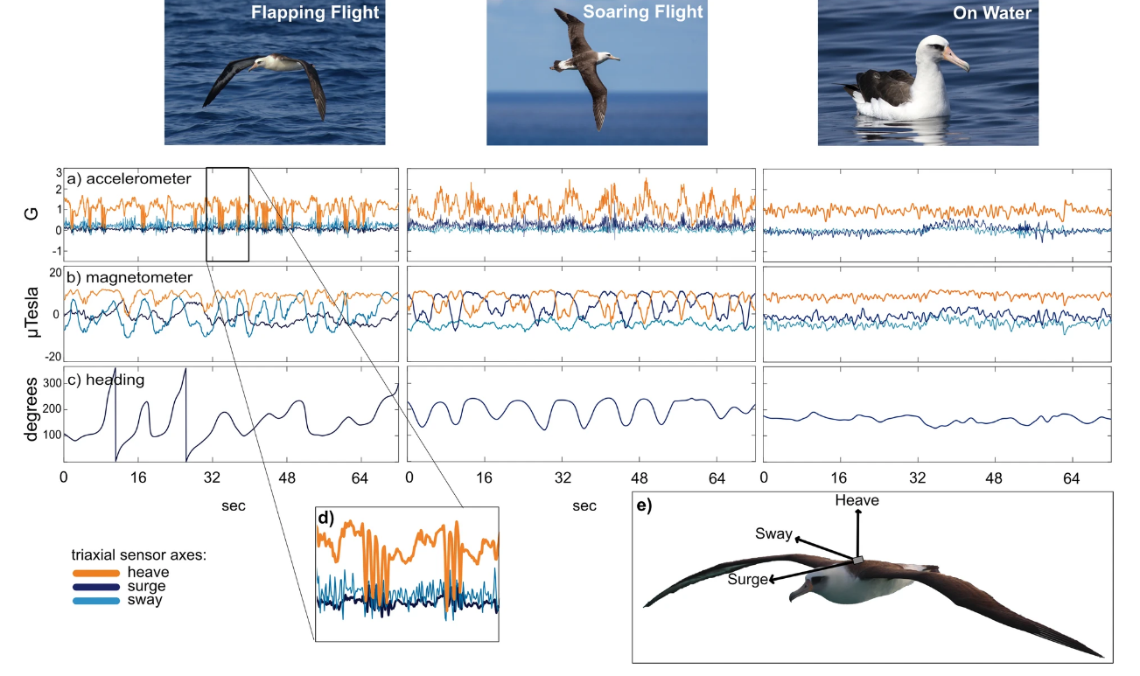
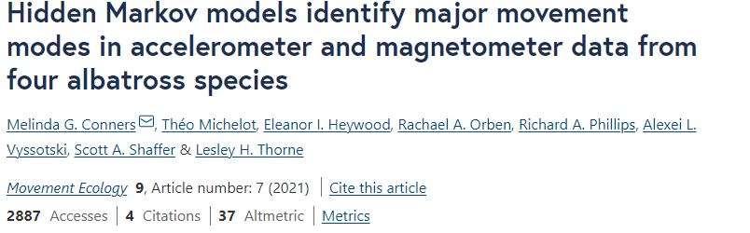

Slide 17
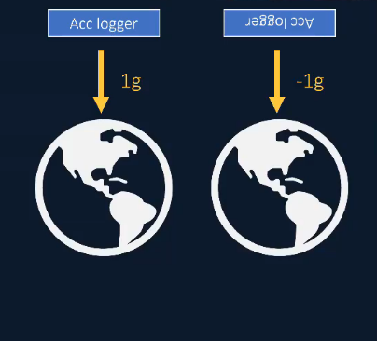
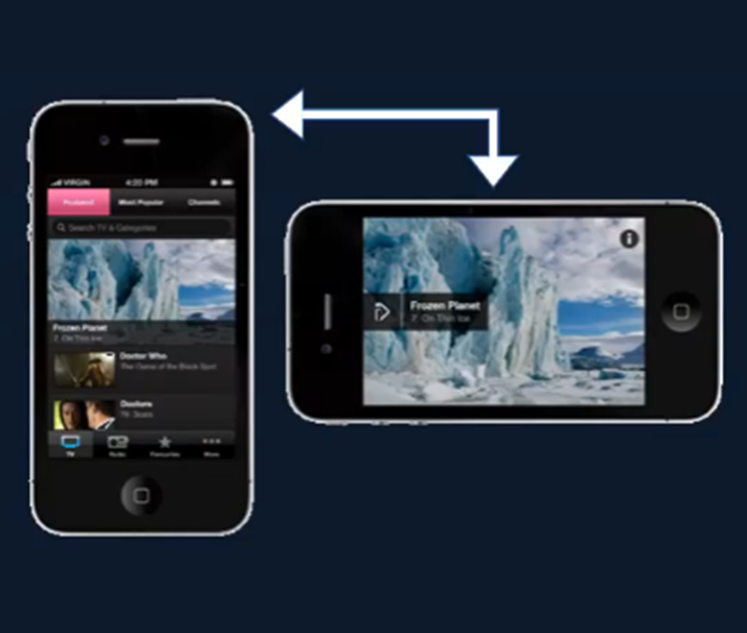
Angle relative to earth’s gravity

Slide 18
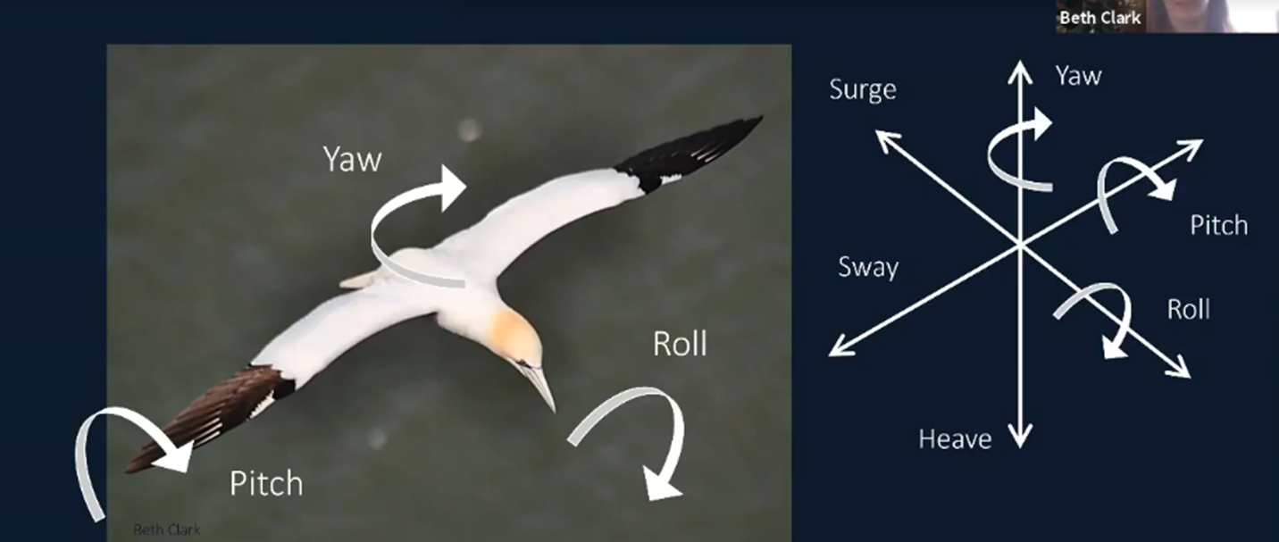


Slide 19
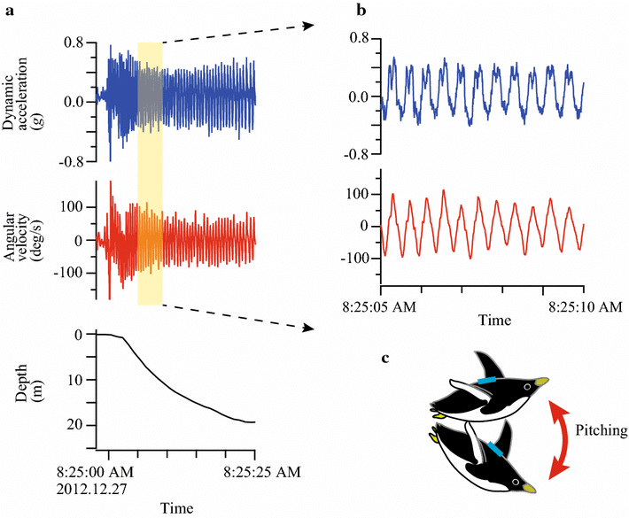
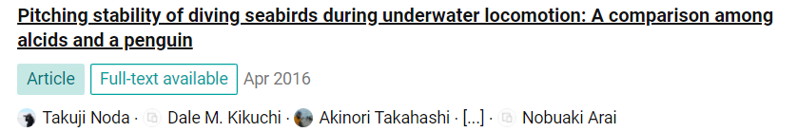
Where the tag is on the body is also important!
To rotate trips to fix differences between tag placements, check out Beth Clark’s Class!

Slide 20
How to analyse Accelerometry?
Proxy for energy expenditure
Behavioural Annotations
Supervised (video, observations, other loggers)
Semi-supervised (partial info + model)
Unsupervised

Slide 21
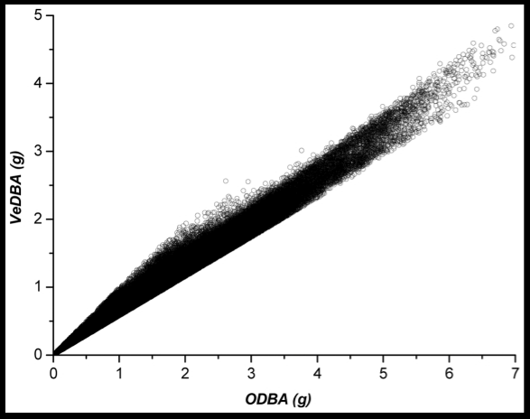
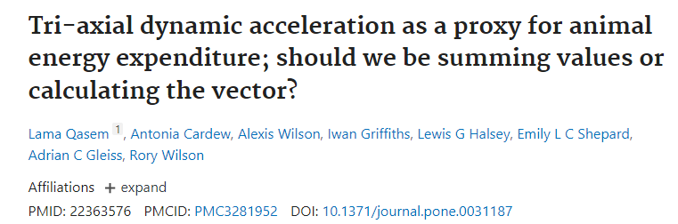
Proxy for energy expenditure
VeBDA: Vectorial Dynamic Body Acceleration
OBDA: Overall Dynamic Body Acceleration

Slide 22
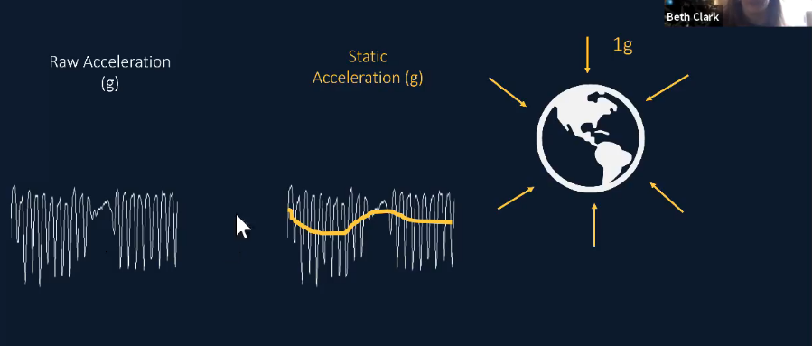
Calculate Dynamic Body Acceleration

Slide 23
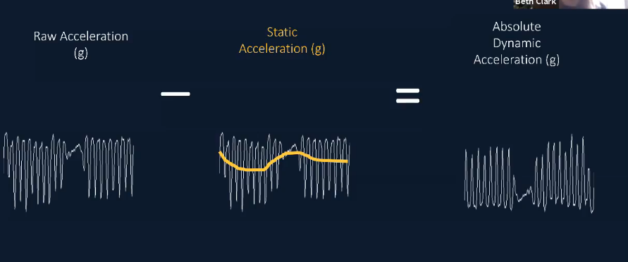
Calculate Dynamic Body Acceleration

Slide 24
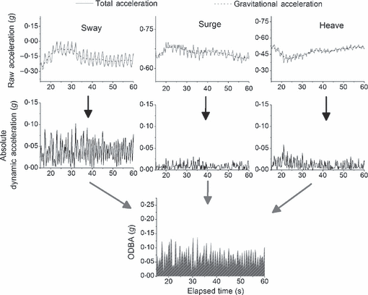
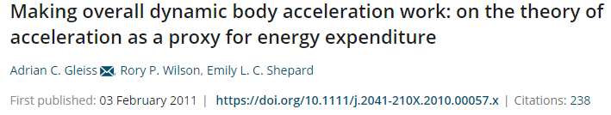
Calculation of OBDA

Slide 25
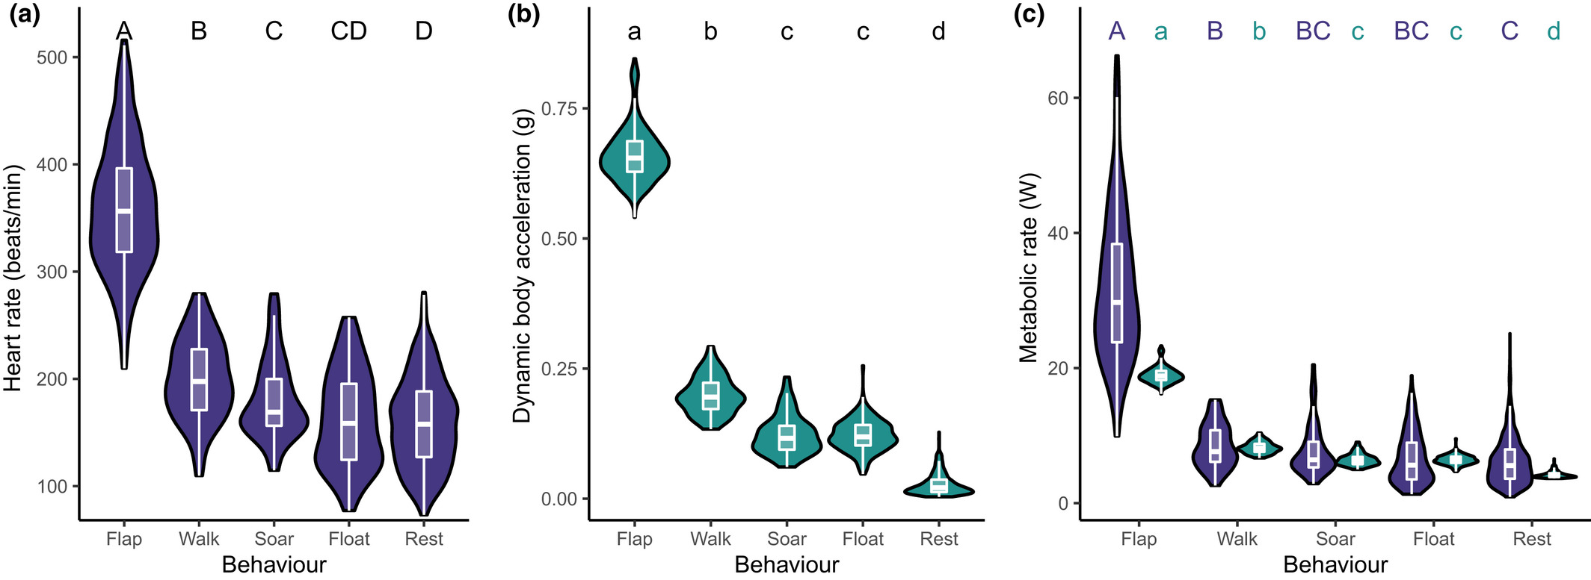
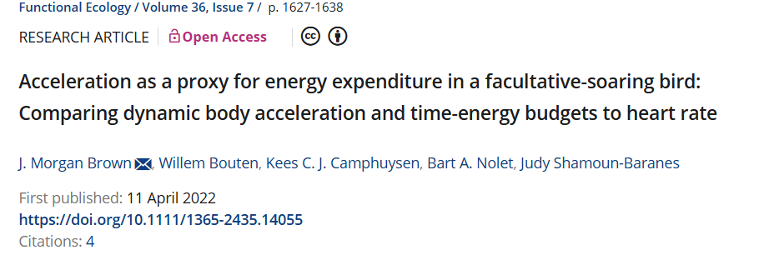
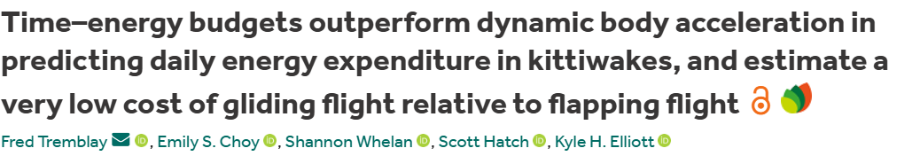

Slide 26
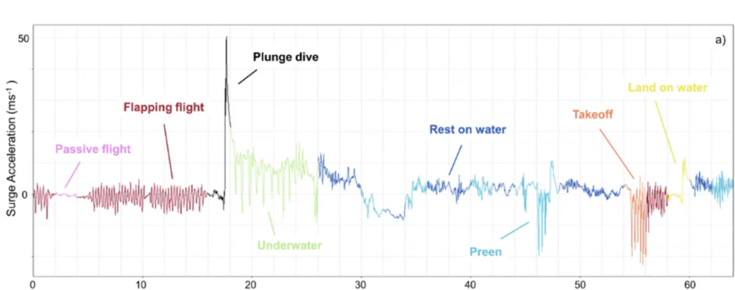
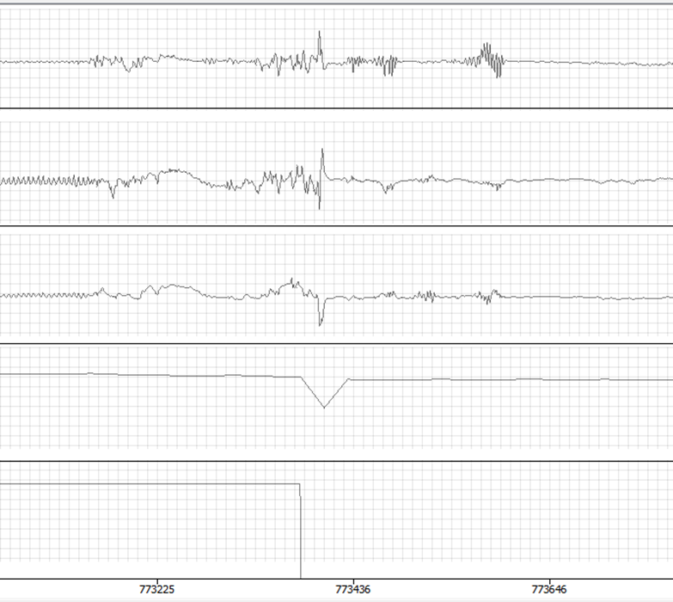
Behavioural Annotation
Label the entire trip
semi-supervised method: label some behaviours and use a model to detect the rest
→

Slide 27

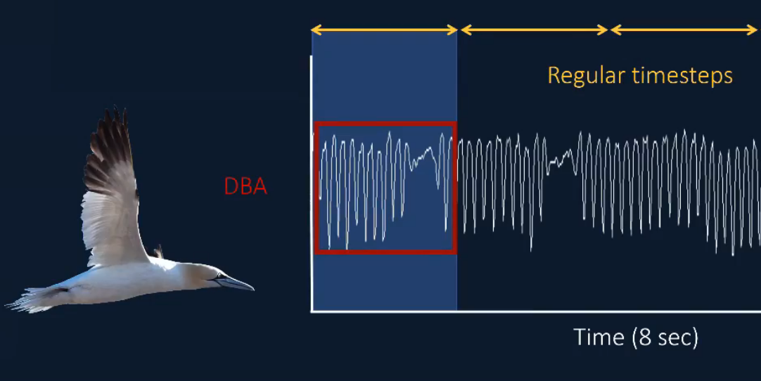
Semi-supervised methods
Calculate summary statistics over regular or irregular timesteps for the entire trip
Label some sections with known behaviours
Run the model to predict unlabelled sections

Slide 28
Many options for identifying behaviours
Framework 4 (Swansea University)
Igor Pro
Hidden Markov Models
Random Forests (check out Beth Clark’s Class)
And many more!

Slide 29
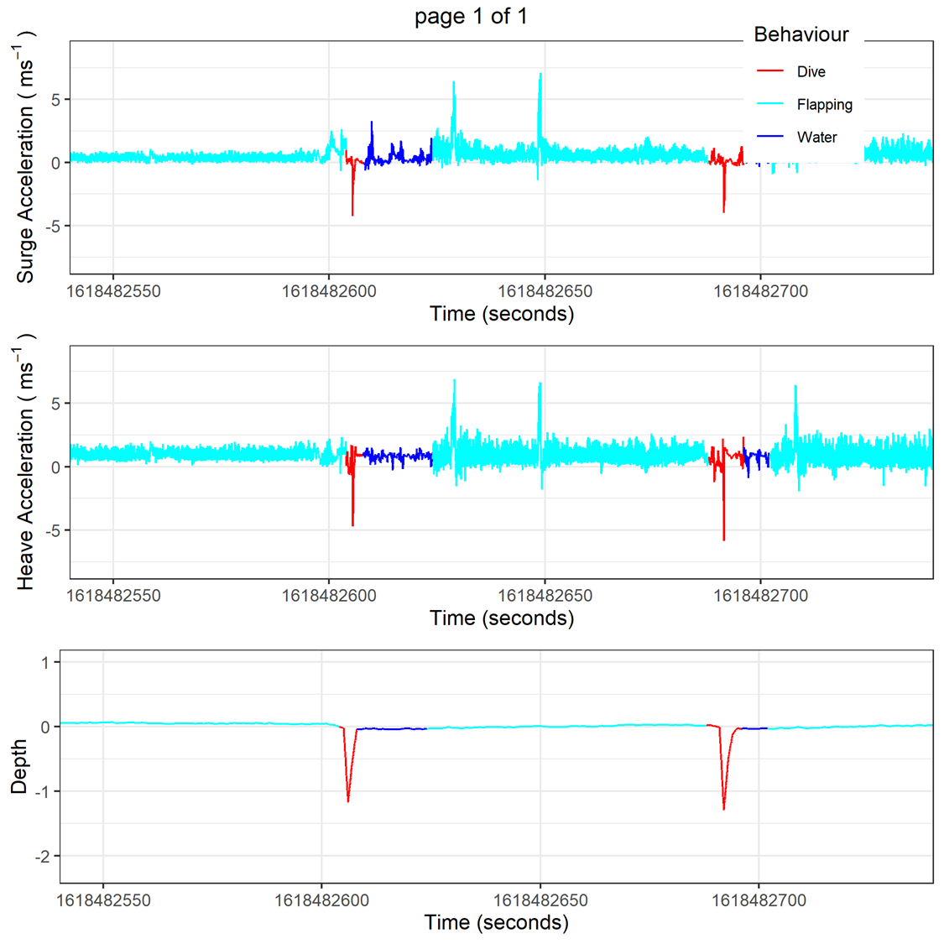
Good model results!

Slide 30
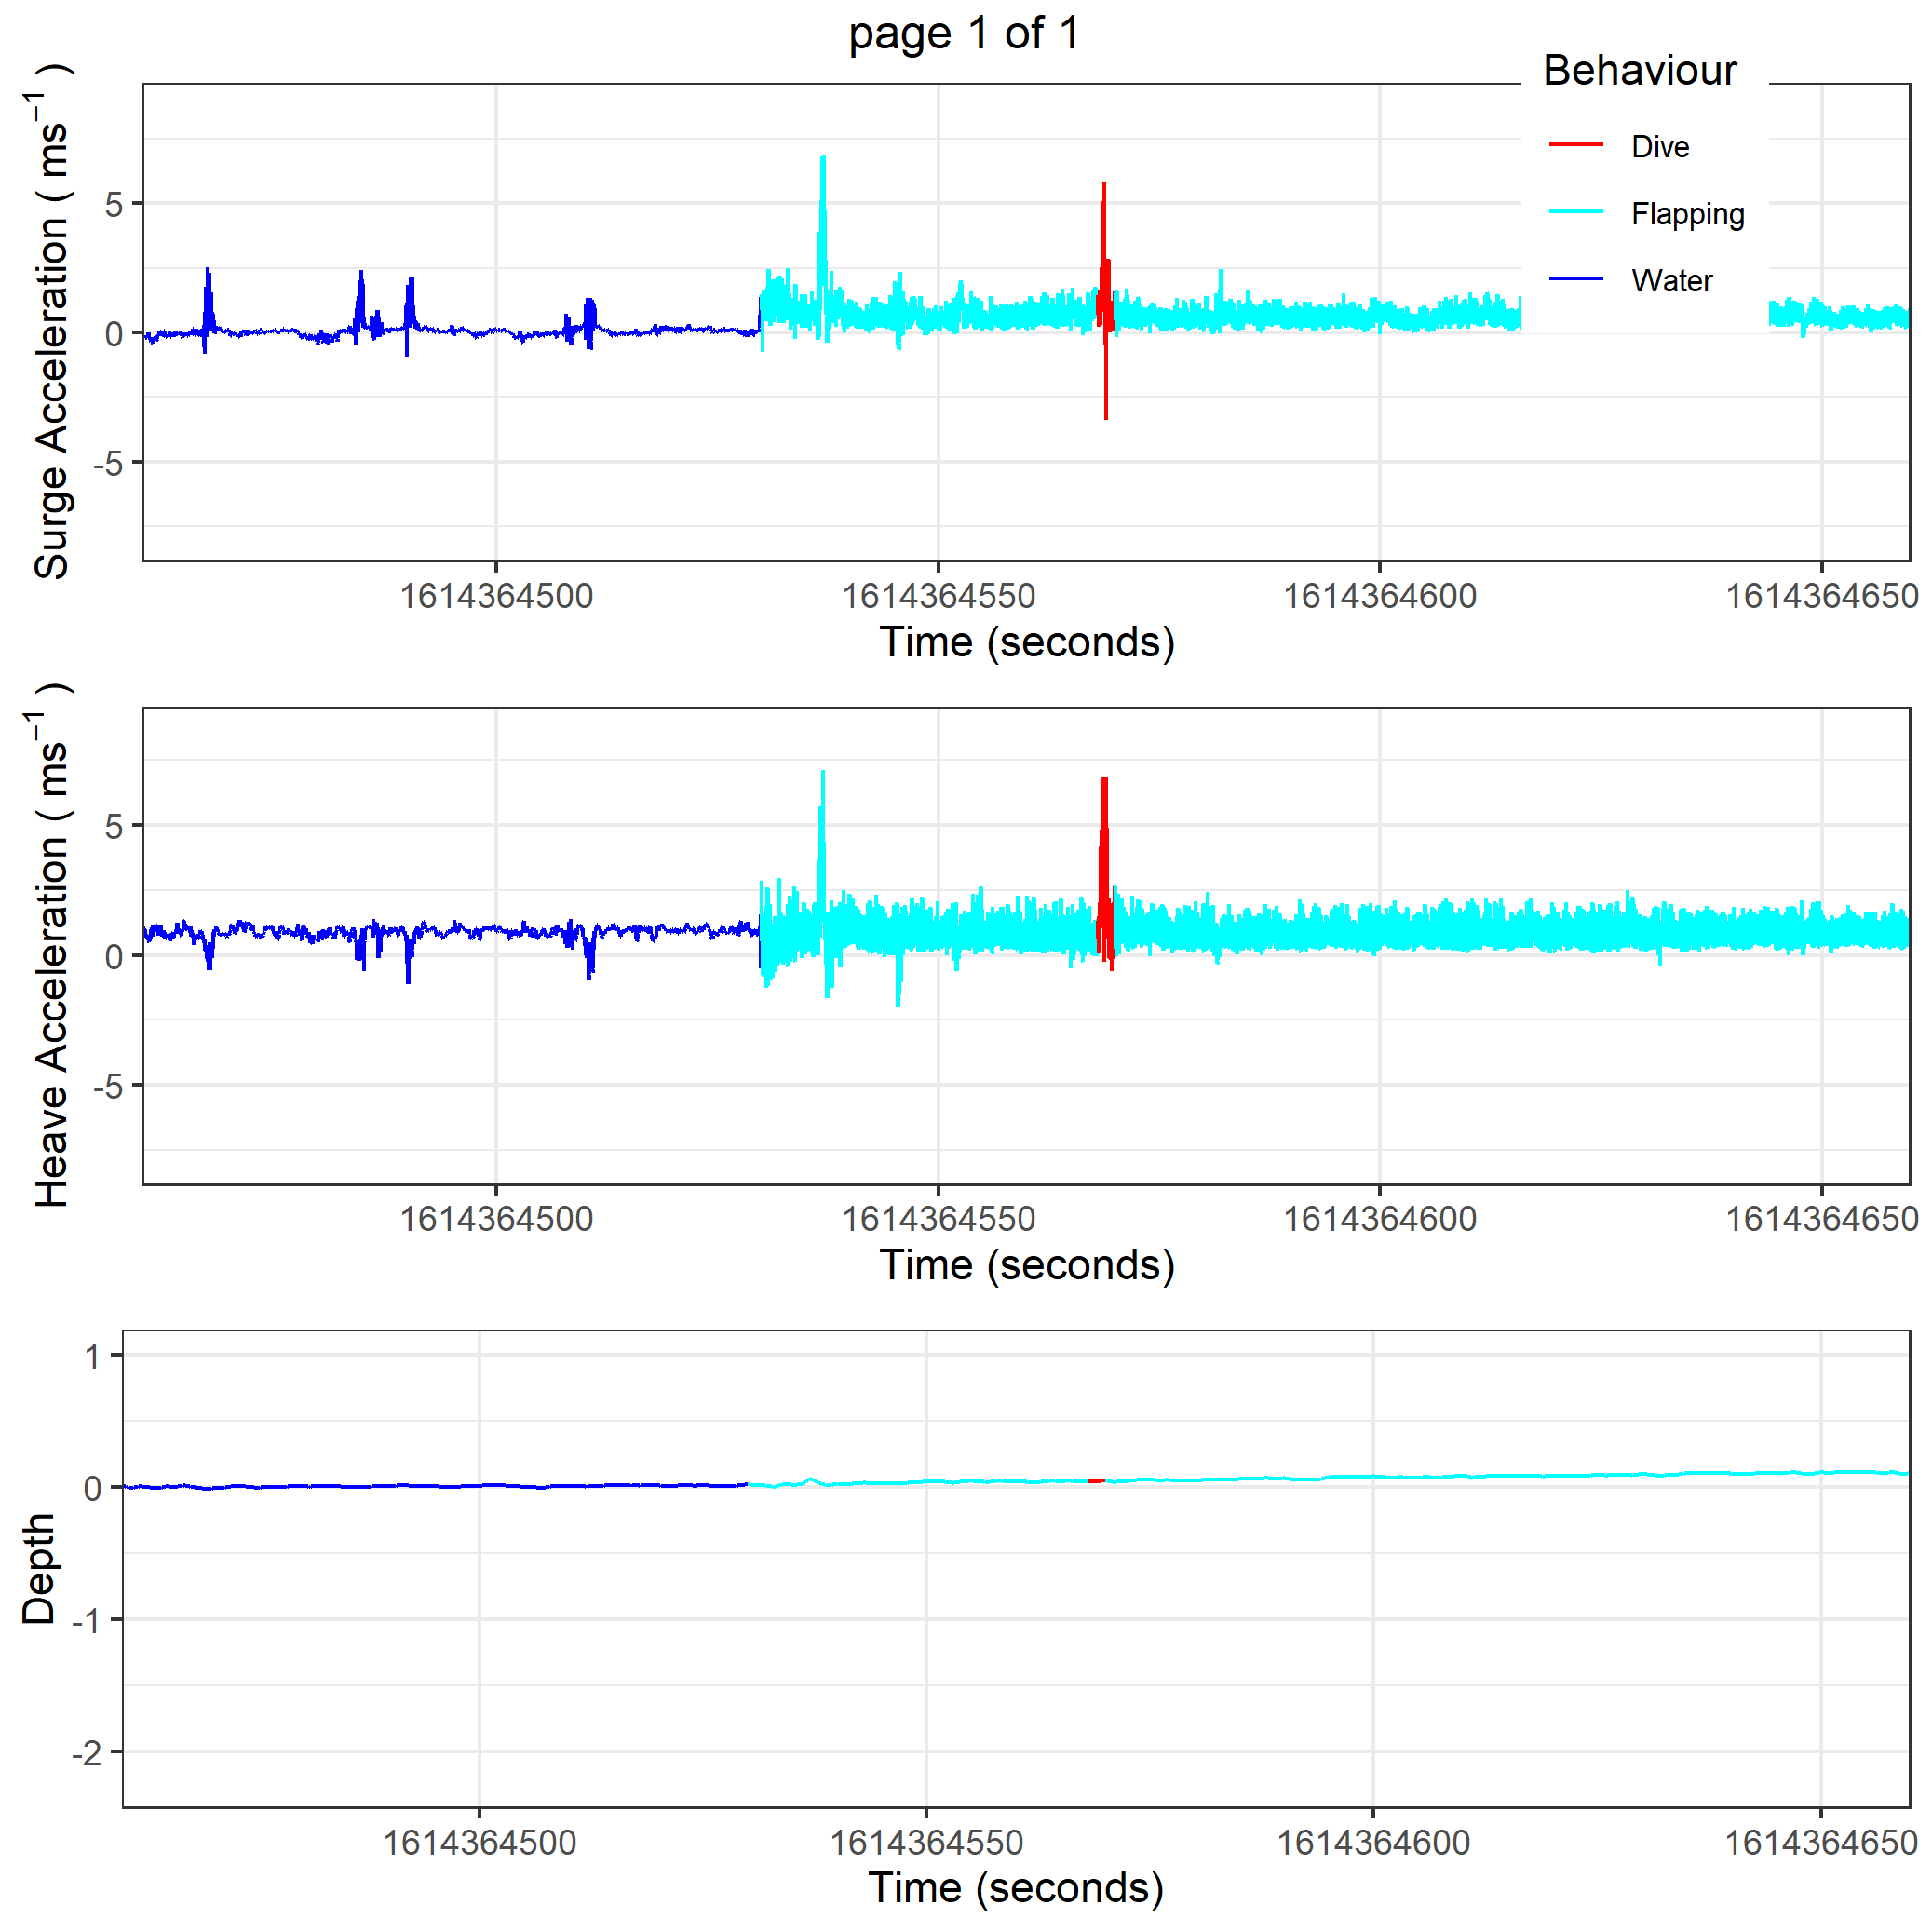
Poor model results!

Slide 31
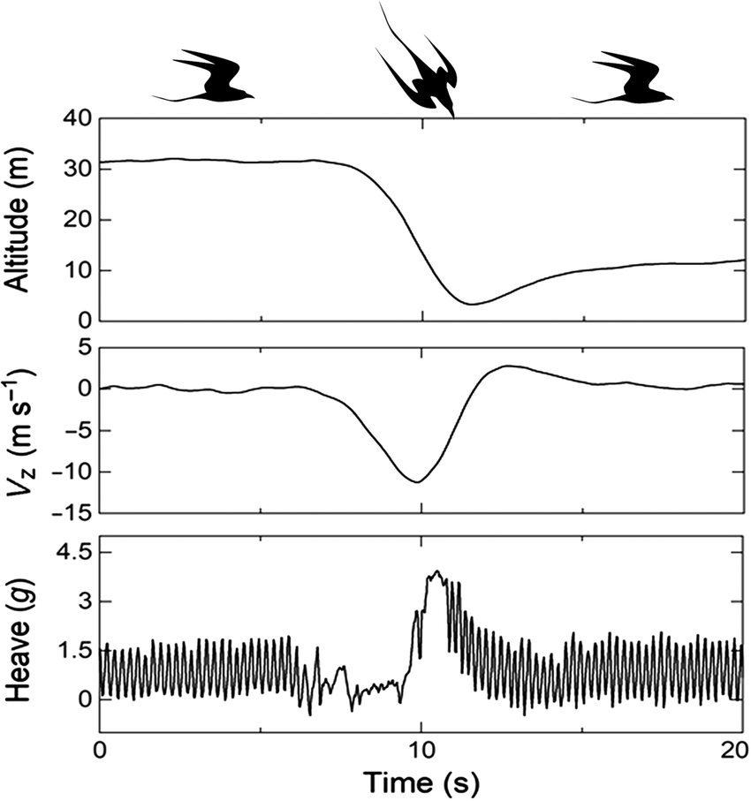
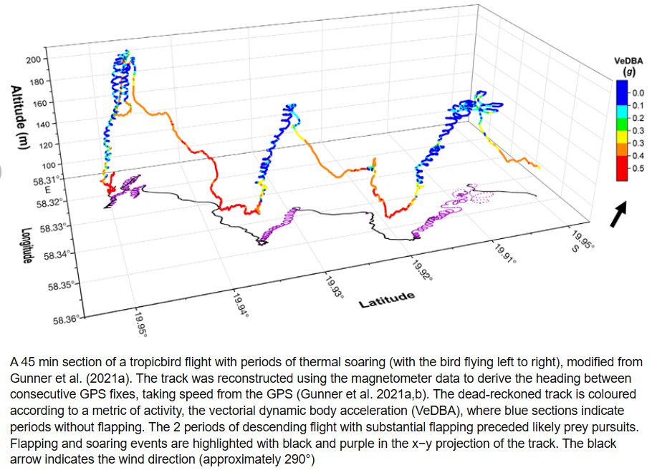
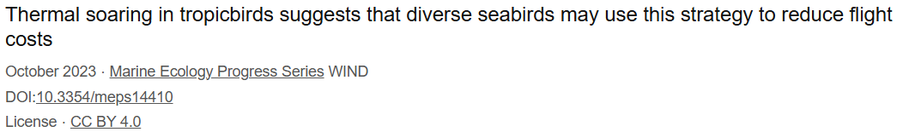
Adding in other datasets & some cool results!

